Slide 1
Dog-breed identification app
Deep learning project work
Minxi Duan, Tamás Bukits
2021 Fall Semester

Slide 2
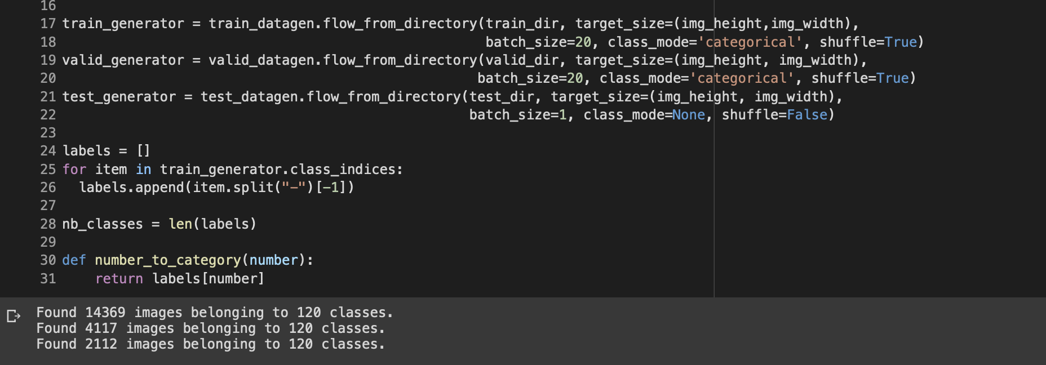
Data splitting
Stanford Dogs Dataset with 20580 images and 120 different labels
We split data into three different folders- train, valid and test
Each folders we have 120 classes, which is the breeds and in each class, we split the photo images with ratio 1:2:7

Slide 3
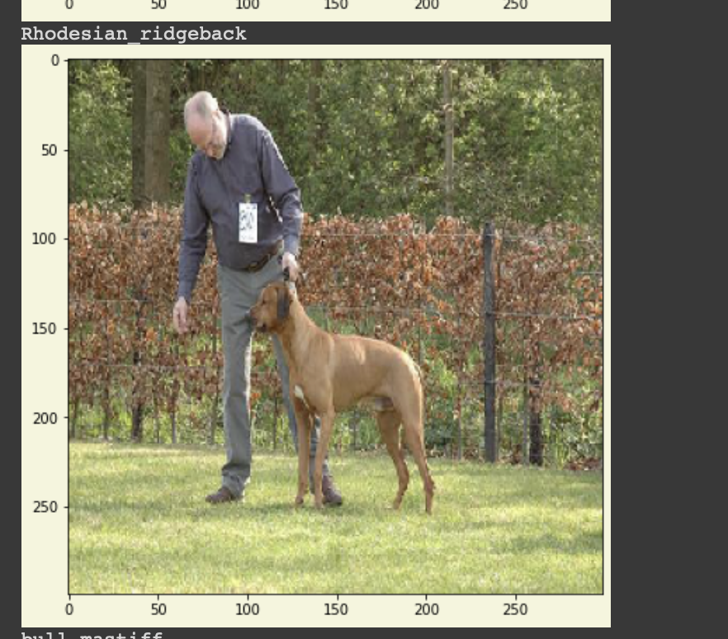
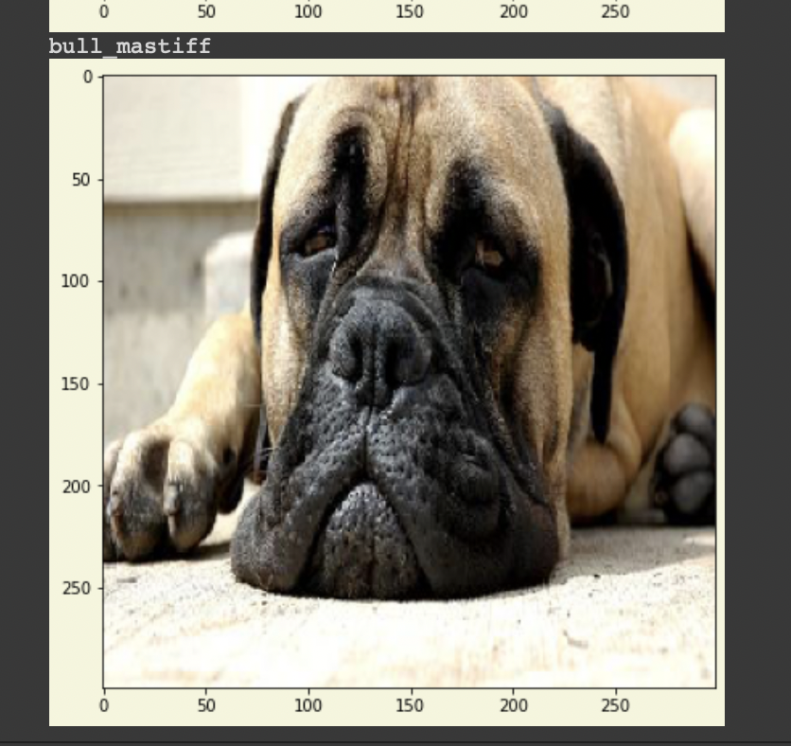

Slide 4
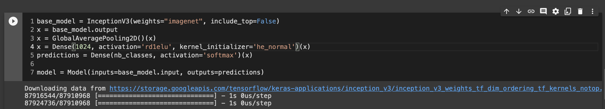
Train the Model
We try to train the model but failed, because we only have 20,000 photos
So we try to use the Transfer Learning — Inception v3
Inception v3
- a convolutional neural network for assisting in image analysis and object detection, and got its start as a module for Googlenet.
We add one more dense layer with 1024 neurones and one more layer for classification

Slide 5
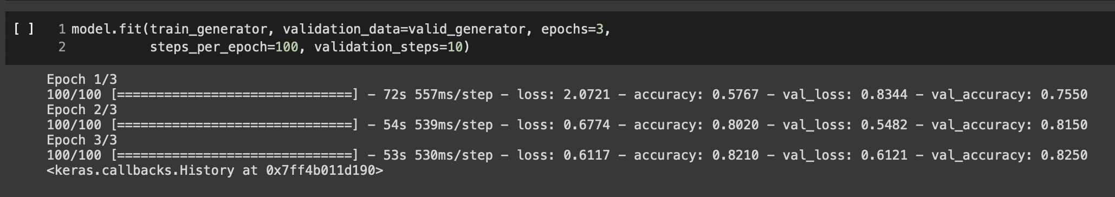
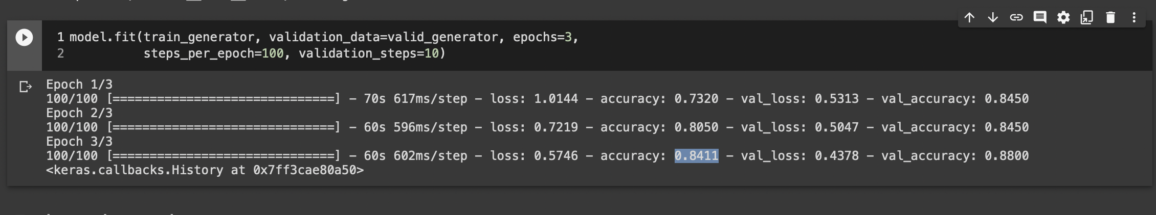
Here we trained the two dense layer and get the accuracy with 0.6
And after we add one more layer with 1024 neurones, we train the dataset again, we get the accuracy with 0.84

Slide 6
Evaluate the results
Evaluation
-Test Accuracy: 0.8620354533195496
Over 86 percent of the valid data has a good prediction

Slide 7
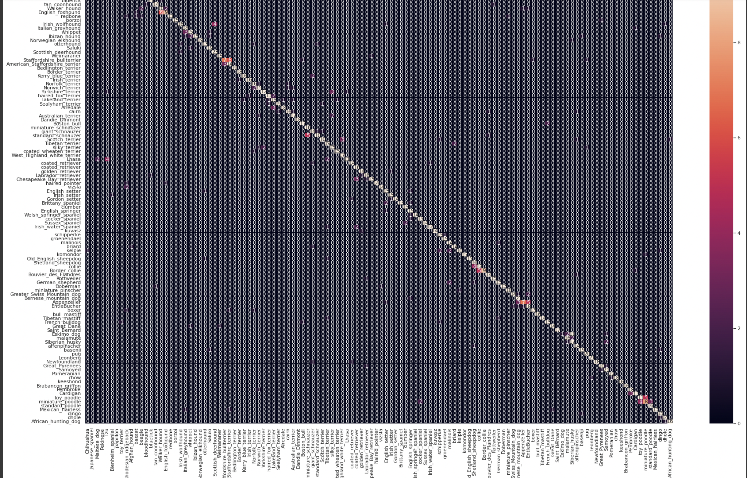
Confusion Matrix

Slide 8
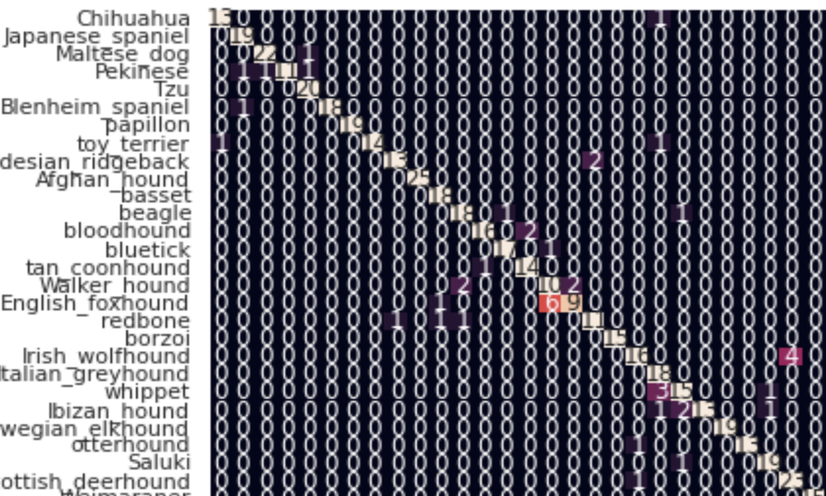

Not very precise
Overall we have a good prediction
but still get some prediction that are not that precise

Slide 9
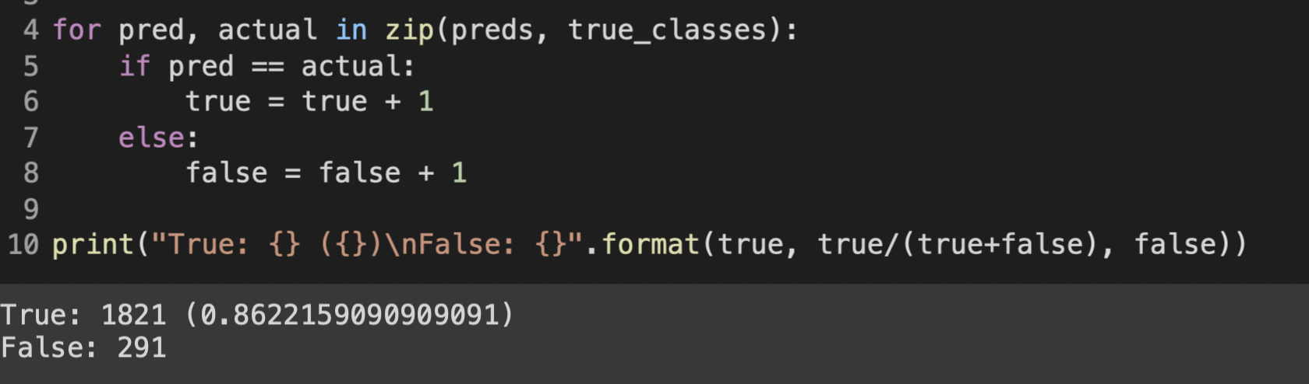
Prediction and Ground True value
For our test data, we got 1821 correct prediction and 291 false prediction

Slide 10
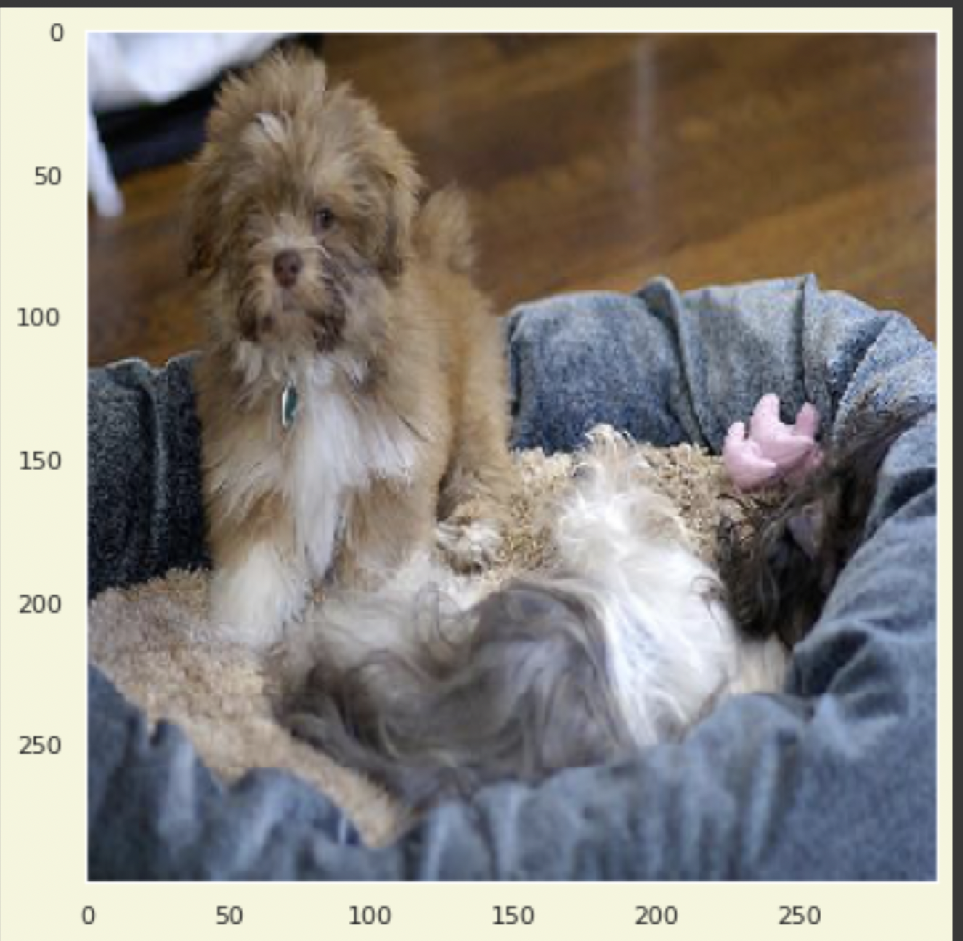
Top three predictions: Lhasa (95.40%), Tibetan_terrier (2.21%), Tzu (1.35%)
Prediction: Lhasa
Ground truth: Lhasa

Slide 11
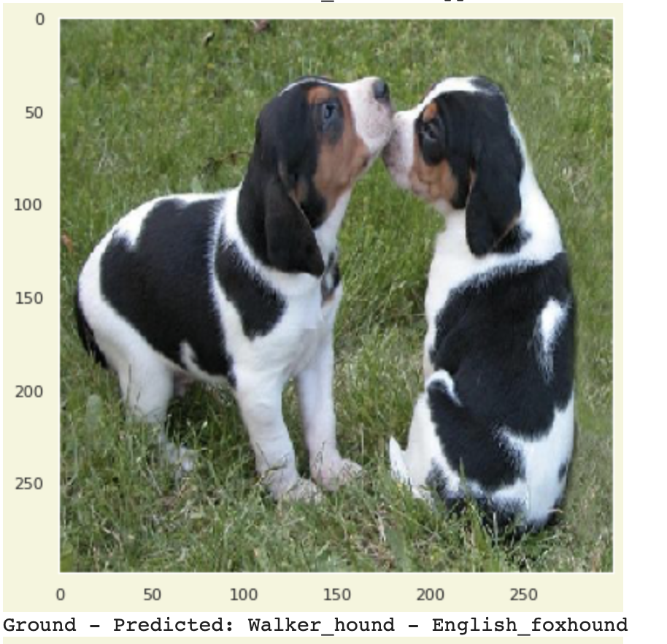
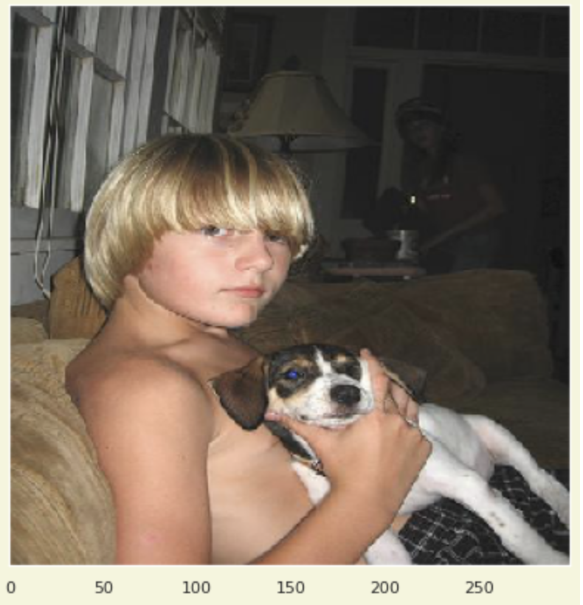
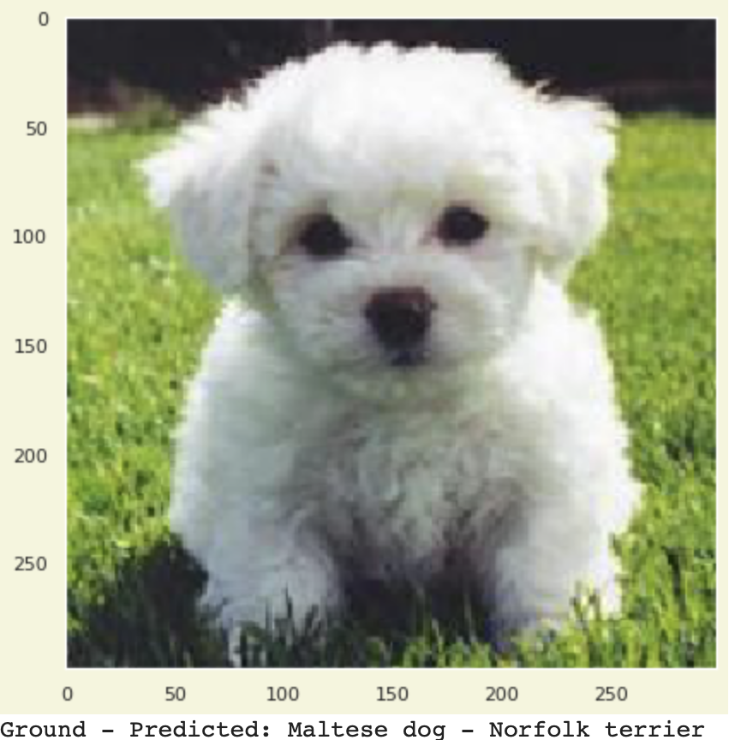
From the misclassification assemble we made, we classified them into three different condition.
First condition, the prediction is almost closed to the actual results with since the prediction have nearly identical characteristics
Second condition, there is a large discrepancy between prediction and reality
Third condition, there are multiple dogs in the photo and our model did not detect the target one but the other dog which is different from the label.

Slide 12
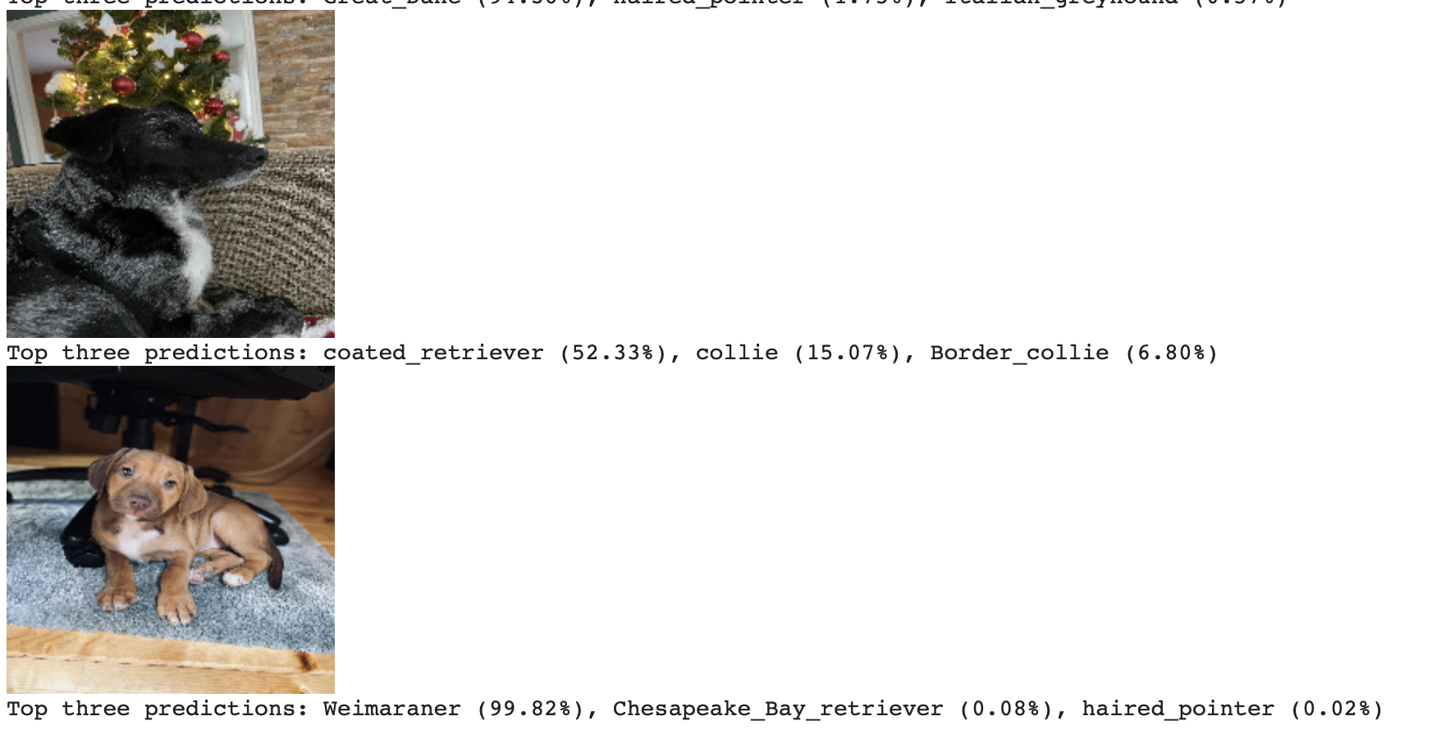
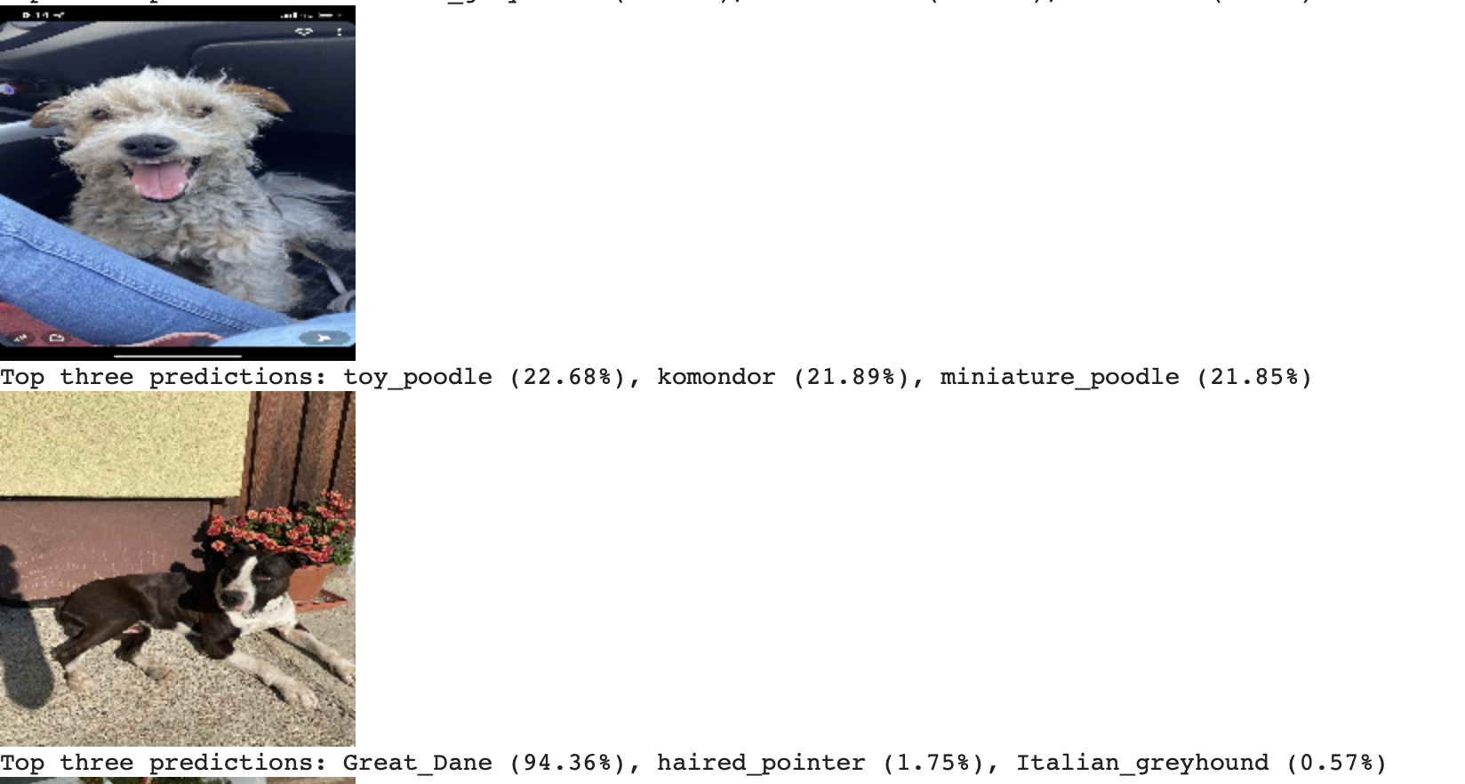
New Result

Slide 13
Thank you !

